Slide 1





Champions

Slide 2
Contents
01
02
03
04
Our Team
Our Goal
Stages of realization
Used Technologies

Slide 3
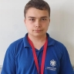
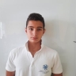
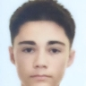
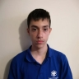
Our Team
Zafir Dinev
Scrum Trainer
Kristiyan Ivanov
Back-end Developer
Mihail Avagyan
Front-end Developer
Lubo Dimov
Back-end Developer

Slide 4

Our Goal
Our goal is to make a website for digital willing.

Slide 5
Stages of realization
1.Organization
2.Decide the idea
Development
4.Presentation

Slide 6








Used Technologies

Slide 7

Let’s move into the site.

